Slide 1
A MINI PROJECT
On
IMAGE CAPTION GENERATOR
BACHELOR OF TECHNOLOGY
IN
COMPUTER SCIENCE AND ENGINEERING
BY
VENKATA SAI SWAPNA PALLAPOTHU - 20VE1A05H8
Under the Guidance of
S. SUNITHA - Assistant Professor
ACADEMIC BATCH: 2020-2024

Slide 2
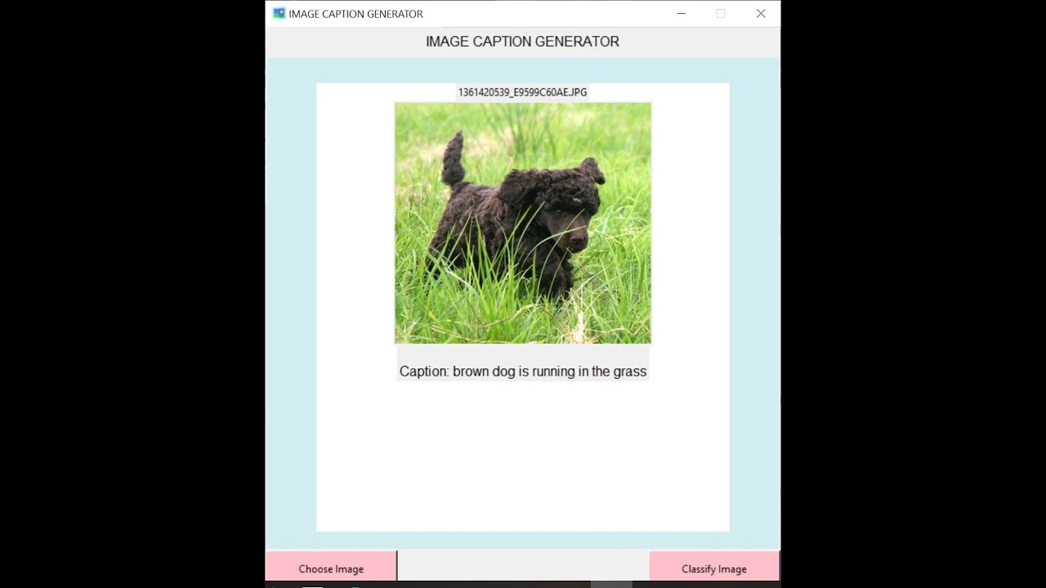
IMAGE CAPTION GENERATOR
CONTENTS
Problem Statement
Literature Survey
Existing System
Drawbacks
Proposed System
Advantages
Software and Hardware
Requirements
Architecture Diagram
Data Flow/ER Diagram
Design and Analysis
Queries

Slide 3
PROBLEM STATEMENT:
To develop an image caption generator, an application of Deep Learning requires passing the image to the model for processing and generating its description.
Convolutional Neural Network and Recurrent Neural Network are used to understand the content of the image and turn the understanding of the image into work in the right order.
Image captioning is a popular research area of Artificial Intelligence (AI) that deals with image understanding and a language description for that image.
Image understanding needs to detect and recognise objects. It also needs to understand scene type or location, object properties and their interactions. Generating well-formed sentences requires both syntactic and semantic understanding of the language. Understanding an image largely depends on obtaining image features.
The objective of our project is to develop a web-based interface for users to get the description of the image and to make a classification system to dififerentiate images as per their description.

Slide 4
LITERATURE SURVEY:
TITLE: Image Caption Generating Deep Learning Model
AUTHORS: Aishwarya Maroju, Sneha Sri Doma, Lahari Chandarlapati
YEAR: 2021
ABSTRACT: Image captioning is the process of generating descriptions about what is going on in the image. By the help of Image Captioning descriptions are built which explain about the images. Image Captioning is basically very much useful in many applications like analyzing large amounts of unlabeled images and finding hidden patterns for Machine Learning Applications for guiding Self driving cars and for building software that guides blind people. This Image Captioning can be done by using Deep Learning Models. With the advancement of deep learning and Natural Language Processing now it has become easy to generate captions for the given images. In this paper we will be using Neural Networks for the image captioning. Convolution Neural Network (ResNet) is used as encoder which access the image features and Recurrent Neural Network (LongShort Term Memory) is used as decoder which generates the captions for the images with the help of image features and vocabulary that is built.

Slide 5
TITLE: Visual Image Caption Generator Using Deep Learning
AUTHORS:Grishma Sharma,Priyanka Kalena,Nishi Malde
YEAR: 2019
ABSTRACT: - Image Caption Generation has always been a study of great interest to the researchers in the Artificial Intelligence department. Being able to program a machine to accurately describe an image or an environment like an average human has major applications in the field of robotic vision, business and many more. This has been a challenging task in the field of artificial intelligence throughout the years. In this paper, we present different image caption generating models based on deep neural networks, focusing on the various RNN techniques and analyzing their influence on the sentence generation. We have also generated captions for sample images and compared the different feature extraction and encoder models to analyse which model gives better accuracy and generates the desired results.

Slide 6
TITLE: Image Caption Generator
AUTHORS:Megha J Panicker, Vikas Upadhayay, Gunjan Sethi, Vrinda Mathur
YEAR: 2021
ABSTRACT: In the modern era, image captioning has become one of the most widely required tools. Moreover, there are inbuilt applications that generate and provide a caption for a certain image, all these things are done with the help of deep neural network models. The process of generating a description of an image is called image captioning. It requires recognizing the important objects, their attributes, and the relationships among the objects in an image. It generates syntactically and semantically correct sentences.In this paper, we present a deep learning model to describe images and generate captions using computer vision and machine translation. This paper aims to detect different objects found in an image, recognize the relationships between those objects and generate captions. The dataset used is Flickr8k and the programming language used was Python3, and an ML technique to demonstrate the proposed experiment. Generating image captions is an important aspect of Computer Vision and Natural language processing. Image caption generators can find applications in Image segmentation as used by Facebook and Google Photos, and even more so, its use can be extended to video frames.

Slide 7
EXISTING SYSTEM
Show and Tell: A Neural Image Caption Generator by Google: This is a neural network-based image captioning system developed by Google that uses a convolutional neural network (CNN) to extract features from images and a long short-term memory (LSTM) network to generate captions.
Neural Talk by Karpathy et al.: Neural Talk is an image captioning system that combines a CNN and a recurrent neural network (RNN) to generate captions for images.
Image Caption by Microsoft: Image Caption is a captioning system that uses a CNN to extract features from images and a deep recurrent neural network to generate captions. It also incorporates attention mechanisms to selectively focus on important regions of the image.

Slide 8
DRAWBACKS
Several existing approaches have been proposed to tackle this problem, Here are some common drawbacks:
Fixed-length captions
lack of creativity and accuracy
vanishing gradient effect
short term memory

Slide 9
PROPOSED SYSTEM
The main aim of this project is to get a little bit of knowledge of deep learning techniques. We use two techniques mainly CNN and LSTM for image classification.
So, to make our image caption generator model, we will be merging these architectures. It is also called a CNN-RNN model.
CNN is used for extracting features from the image. We will use the pre-trained model exception.LSTM will use the information from CNN to help generate a description of the image.
This project is proposed to be used in robotics, using image caption generator robotics can determine the surrounding conditions and show intelligence like humans, using image caption generator robots can make better decisions by understanding the environmental conditions.
Self driving cars can also detect the traffic signal using an image caption generator, when the traffic signal is red, the computer will detect it and stop the car and follow the traffic laws.

Slide 10
ADVANTAGES:
Here are some common advantages:
Overcome the vanishing gradient problem
increase accuracy and creativity
retain information for longer period(long term memory)
sequence prediction problems

Slide 11
REQUIREMENTS
HARDWARE REQUIREMENTS-
GPU
Ram
Processor
Storage
Network Bandwidth

Slide 12
SOFTWARE REQUIREMENTS-
Python
Tensorflow
Keras
matplotlib
Flickr8k Dataset

Slide 13
IMPLEMENTATION
Implementing an image caption generator involves several steps:
Data collection: Collect a dataset of images and corresponding captions. This can be done by scraping images and captions from the internet or using pre-existing datasets such as FLICKR8K DATASET
Data preprocessing: Preprocess the images and captions to prepare them for the model. This may involve resizing the images, normalizing the pixel values, and tokenizing the captions into individual words.
Model architecture: Choose a suitable model architecture for the image caption generator, such as a CNN-RNN or transformer-based model. This involves designing the structure of the image encoder and language decoder, as well as specifying hyperparameters such as the number of layers and the size of the hidden state.
Training: Train the model using the preprocessed data. This involves feeding pairs of images and captions into the model and adjusting the weights of the model to minimize the difference between the predicted and ground truth captions. This may take several hours depending on the size of the dataset and complexity of the model.
Evaluation: Evaluate the performance of the model by testing it on a held-out dataset of images and captions. This involves measuring metrics such as BLEU score to determine the accuracy of the generated captions.

Slide 14
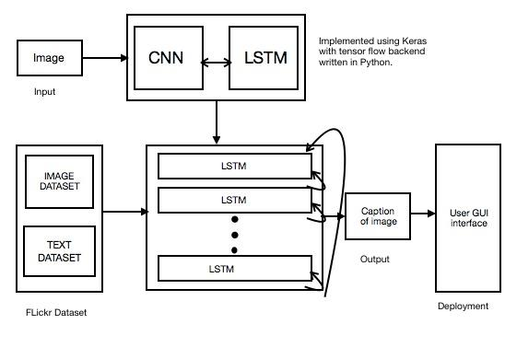
ARCHITECTURE DIAGRAM
The architecture of an image caption generator is a complex system that involves various components working together to generate informative and engaging captions. The first component is the image encoder(CNN), which processes the input image and extracts relevant features using deep learning techniques. The second component is the language model or decoder(RNN), which generates the text description based on the extracted features from the image encoder. Finally, the attention mechanism is used to align the generated text with the corresponding regions in the input image.

Slide 15

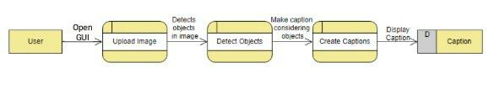
DATA FLOW DIAGRAM
Data Flow Diagram Level 0
Data Flow Diagram Level 1

Slide 16
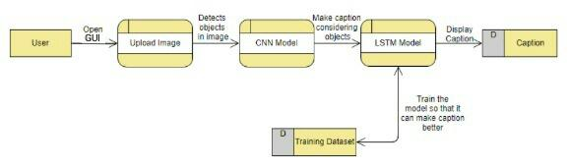
Data Flow Diagram Level 2

Slide 17
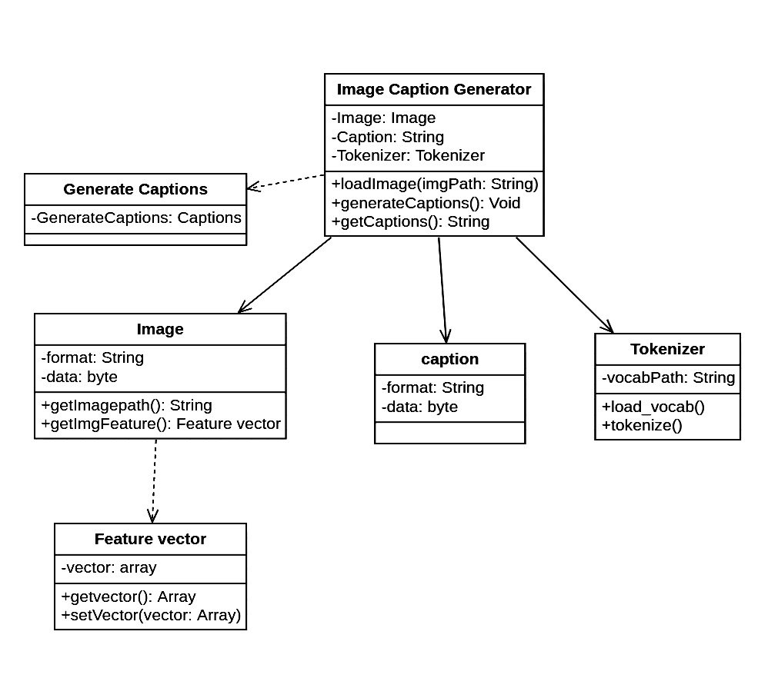
CLASS DIAGRAM
A class diagram illustrates the static structure of the system by showing the classes, their attributes, and relationships. For an image caption generator, you might have classes like Image, Caption, and Caption Generator. The Image class would have attributes like image Data and image Metadata, while the Caption class might have an attribute called caption Text. The Caption Generator class could have a method called generate Caption that takes an Image object and returns a Caption object.

Slide 18
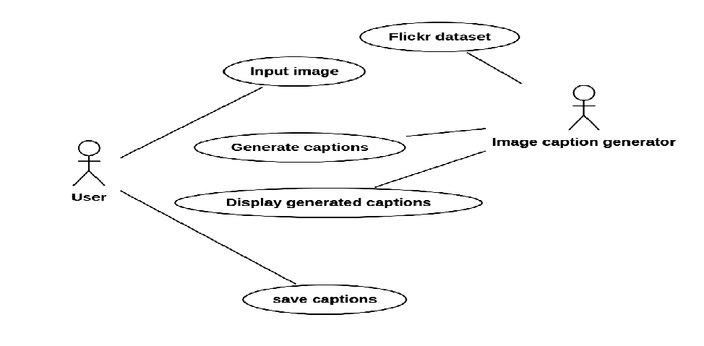
USE CASE DIAGRAM
A use case diagram depicts the interactions between the system and its users. In the case of an image caption generator, the primary actors would be the "User" and the "Image Caption Generator System." The diagram shows the various use cases that the user can perform, such as uploading an image, generating captions, and viewing generated captions.

Slide 19
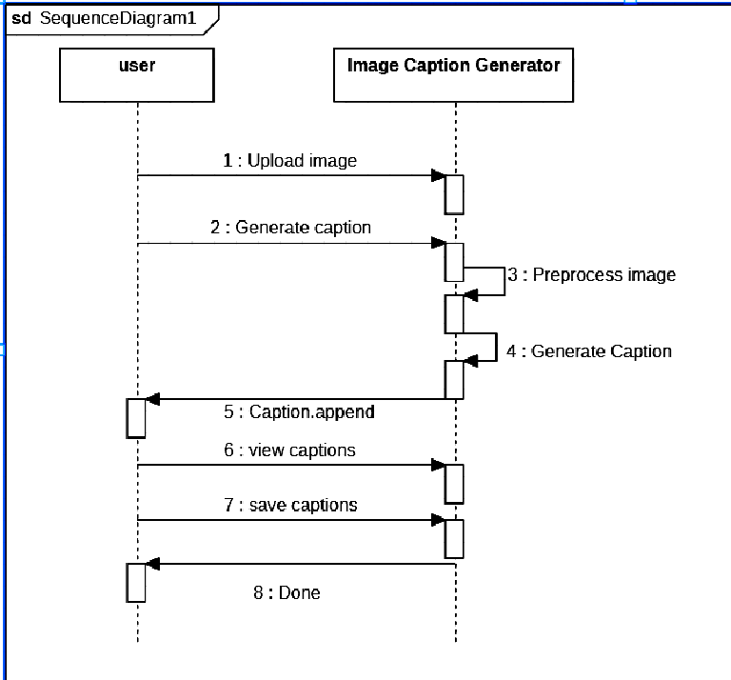
SEQUENCE DIAGRAM
The sequence starts with the User uploading an image to the Image Caption Generator. The Image Caption Generator then passes the image to the Preprocessing Module, which preprocesses the image and returns the preprocessed image to the Image Caption Generator then sends the preprocessed image to the CNN Model, which extracts image features and returns them to the Image Caption Generator. The Image Caption Generator then feeds the image features to the LSTM Model, which generates a caption sequence and returns it to the Image Caption Generator.

Slide 20
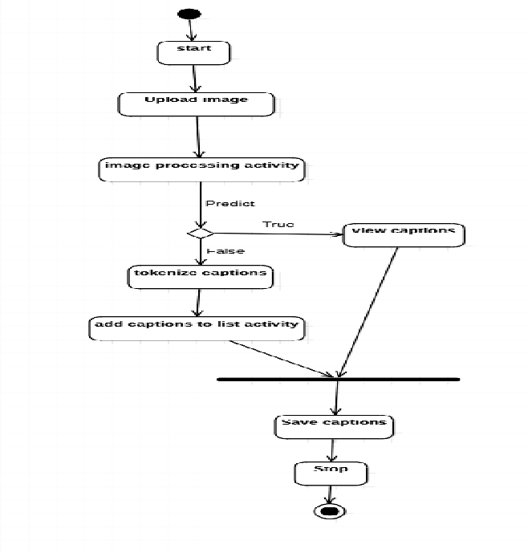
ACTIVITY DIAGRAM
In this activity diagram, the process begins with the user uploading an image. The diagram then branches into two paths based on whether an image was uploaded or not. If an image was uploaded, the image goes through several steps: preprocessing, feature extraction, caption sequence generation, and postprocessing. Finally, the generated caption is displayed and the process stops.

Slide 21
QUERIES ??

